Slide 1


RRSW 2018
Deep Learning for semantic segmentation of SAR images
Sanja Scepanovic, Vladimir Ignatenko

Slide 2

Motivation:
Flood/coastline detection
Urban/agriculture mapping
Existing methods:
Often require expert input

Slide 3
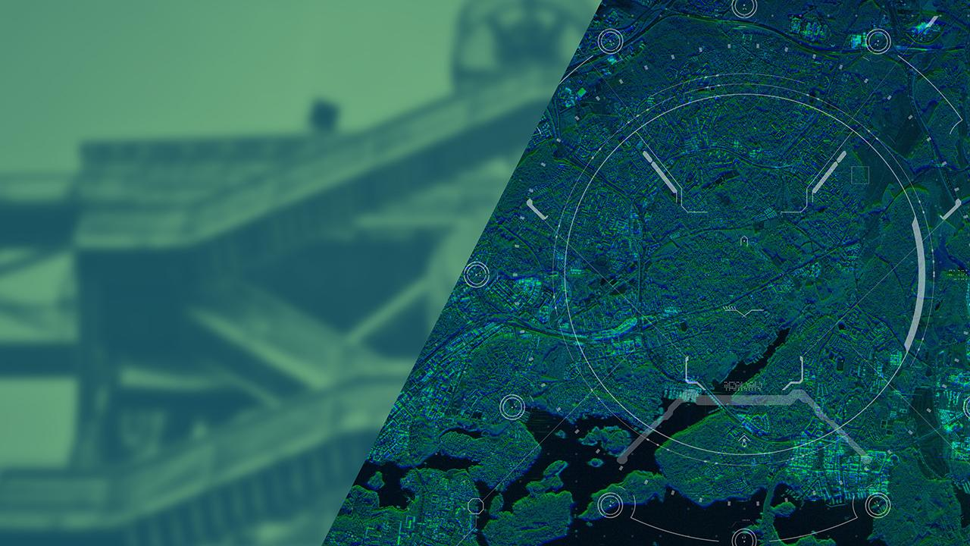
Deep Learning methods
classification
object detection
semantic segmentation
Transfer learning
CNN’s are data hungry
We can use pretrained models, even from another domain!!!

Slide 4
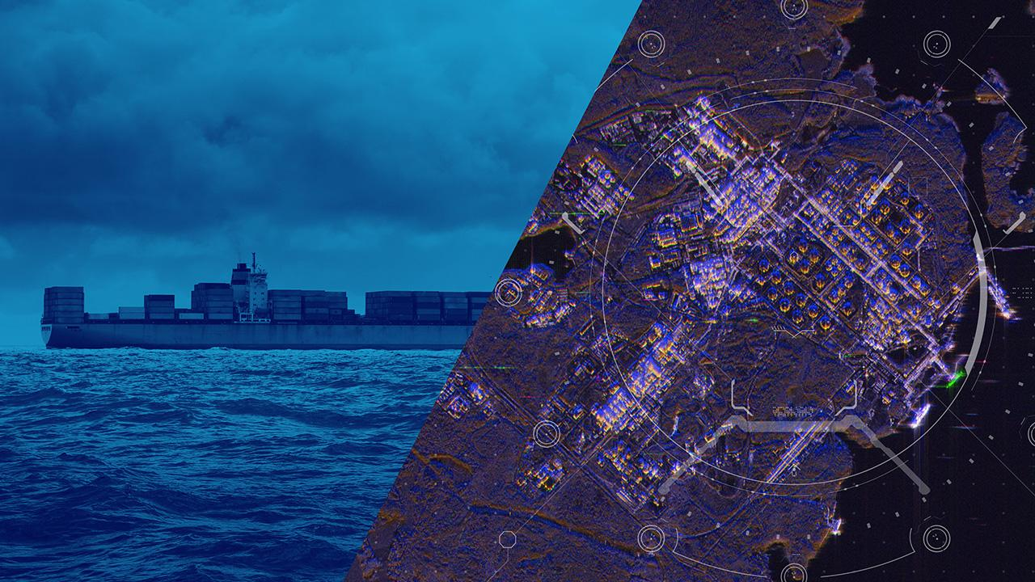
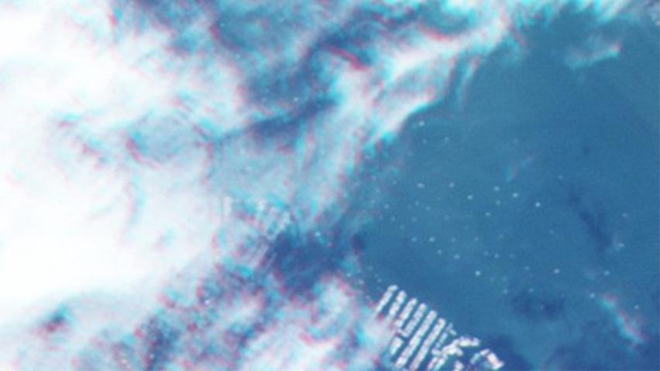
DEEP LEARNING FOR SAR DATA
ATR
Scene understanding
Semantic segmentation

Slide 5
CORINE Land cover
Sentinel -1 imagery
Finland 20x20 m resolution
48 classes
6 superclasses
23x23 m resolution SM
20x22 m resolution IW

Slide 6
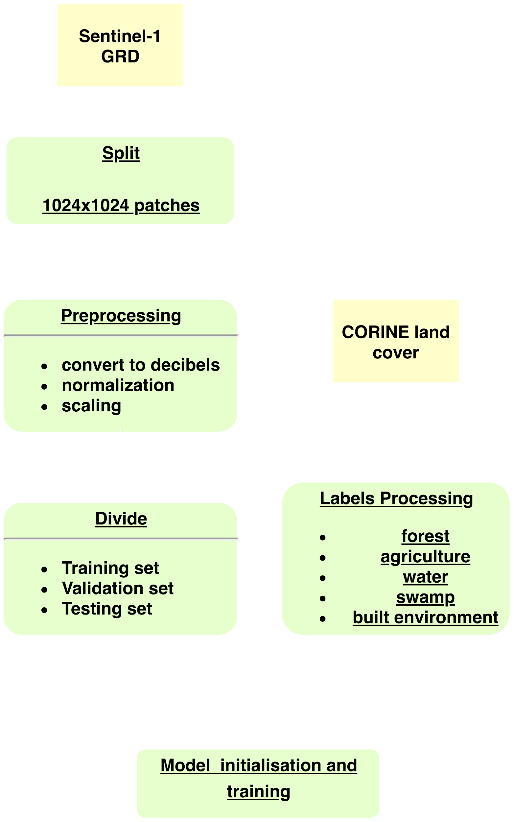
DL Semantic Segmentation Framework

Slide 7
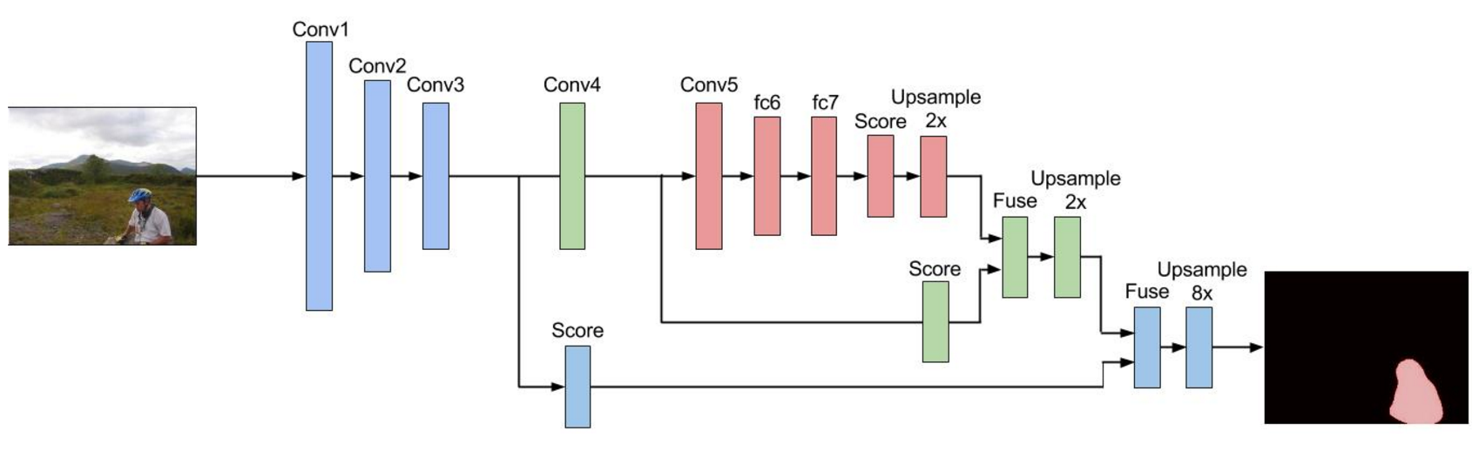
FULLY CONVOLUTIONAL NEURAL NETWORKS (FCNN)
FOR SEMANTIC SEGMENTATION
Basic FCNN (slide credit to Leonardo Araujo dos Santos)

Slide 8
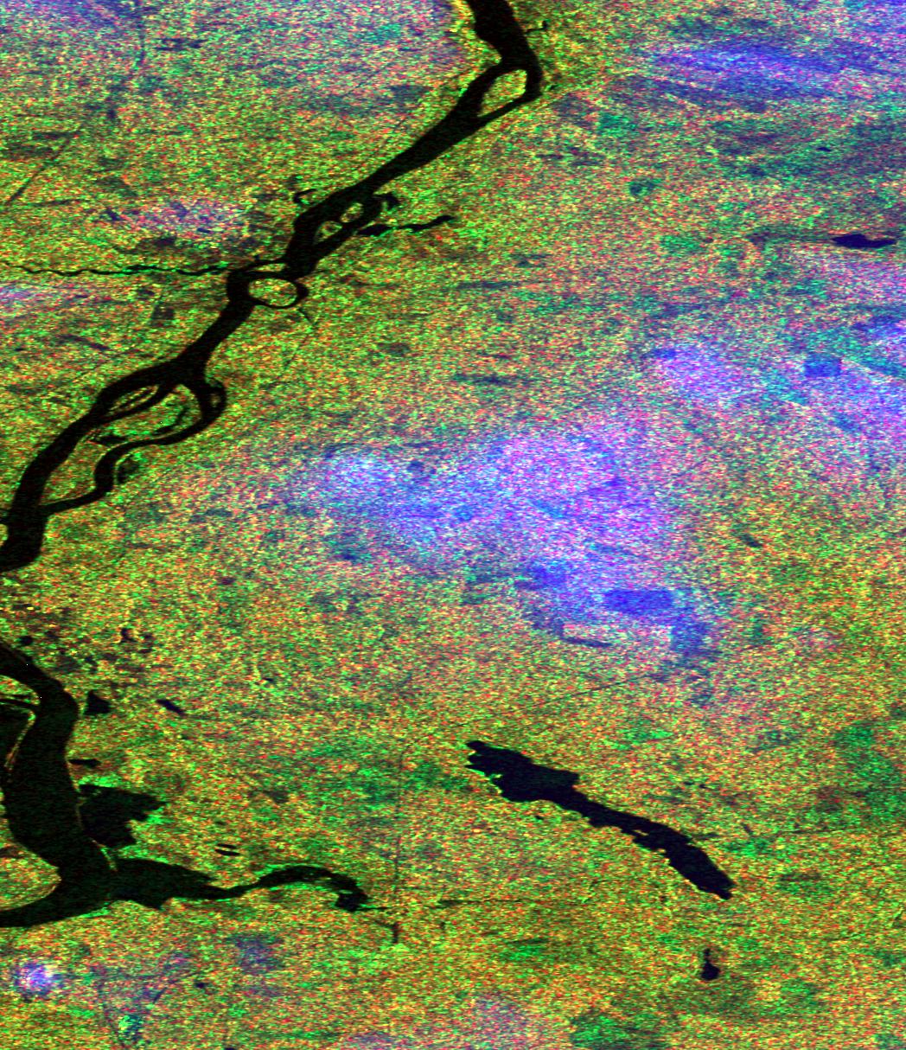
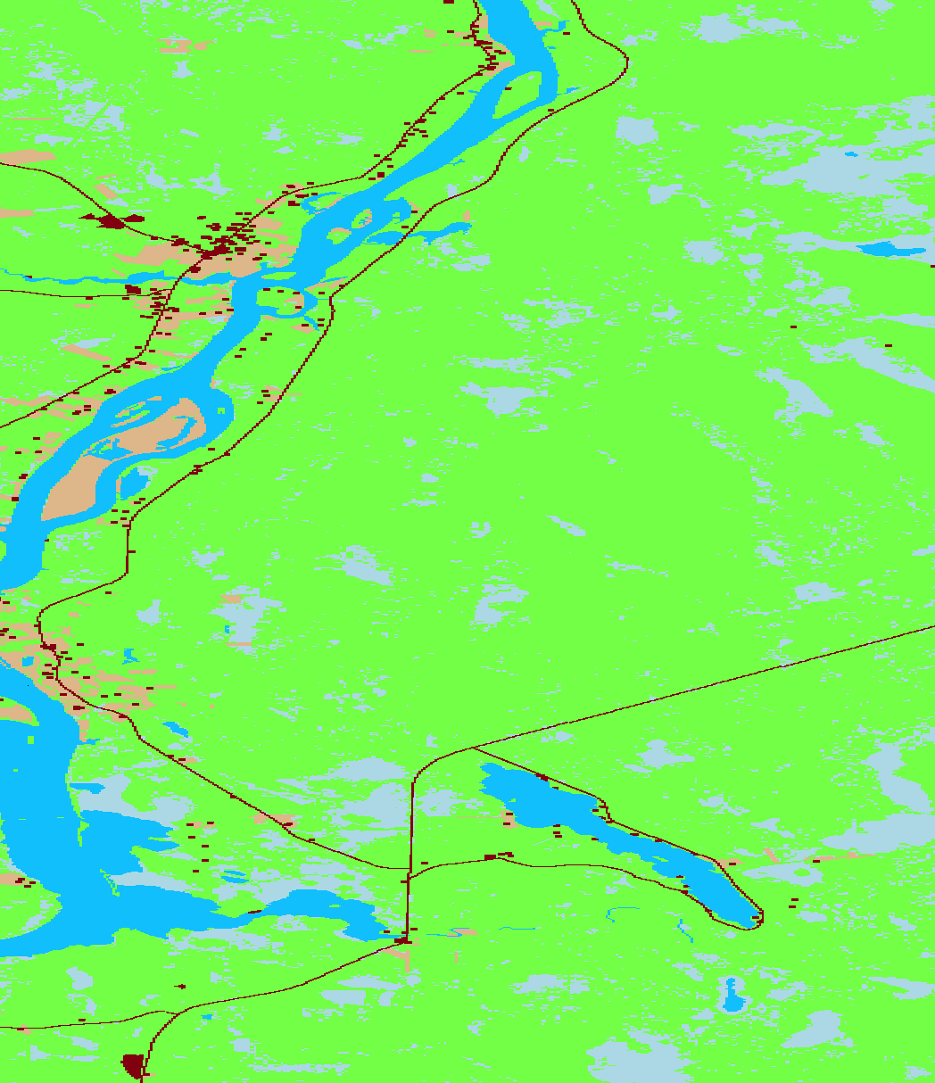
EXAMPLE TRAIN /VALIDATION/TEST AND LABEL DATA

Slide 9
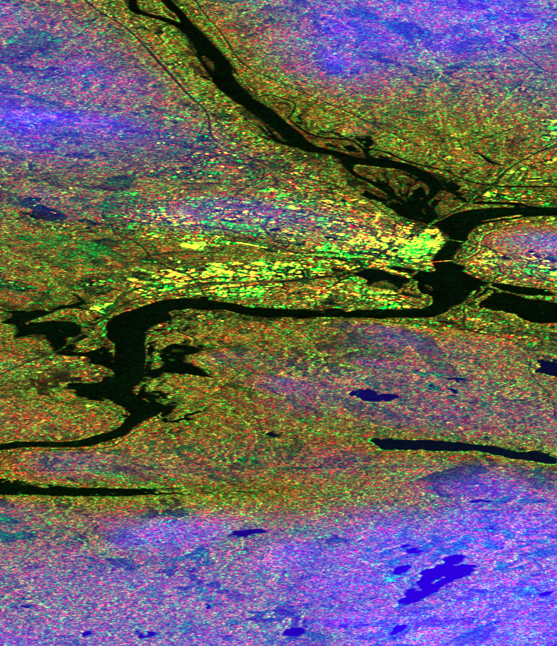
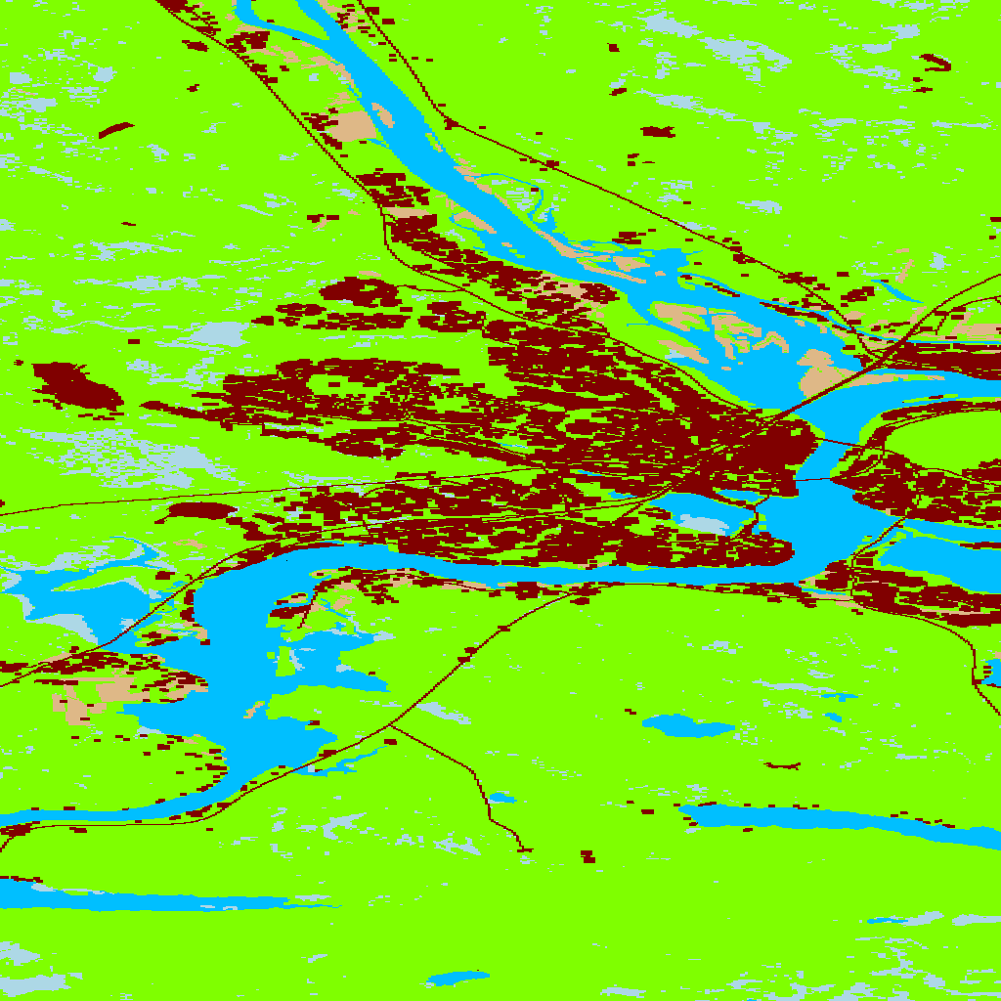
EXAMPLE TRAIN /VALIDATION/TEST AND LABEL DATA

Slide 10
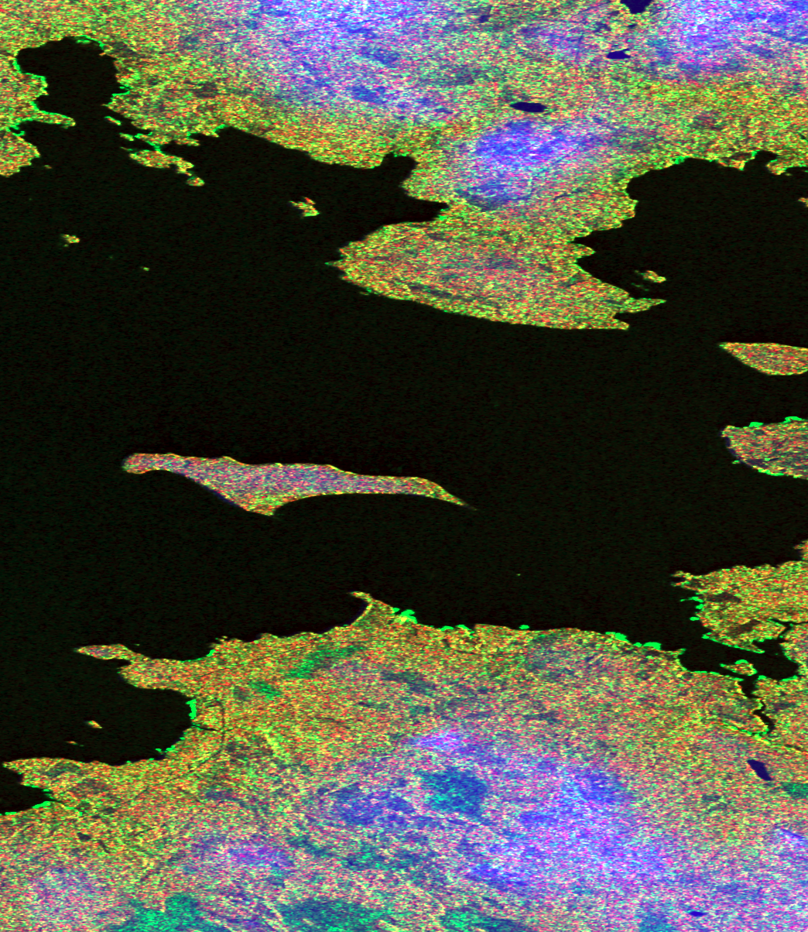
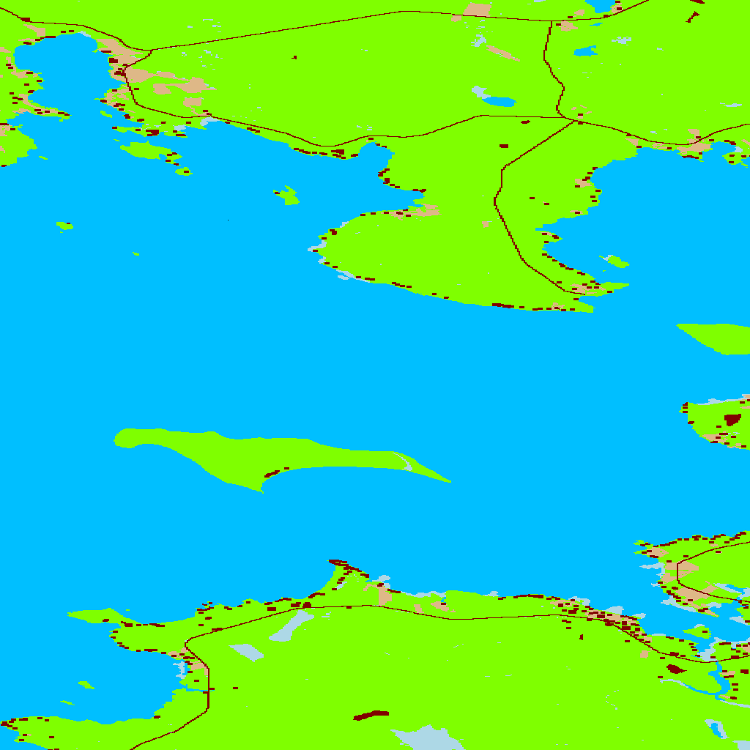
EXAMPLE TRAIN /VALIDATION/TEST AND LABEL DATA

Slide 11
SEMANTIC SEGMENTATION DL MODELS
FC-DenseNet
DeepLab-V3
RefineNet
GCN-Res101
DeepLab-V3-plus

Slide 12
RESULTS after 300 epochs
Model | Prec | F1 | IoU | Forest | Water | Swamp | B.E. | Agr.
FC-DenseNet | .80 | .83 | .31 | .94 | .58 | .15 | .10 | .60
DeepLab-V3 | .87 | .81 | .33 | .95 | .58 | .25 | .09 | .15
RefineNet | .87 | .77 | .31 | .93 | .39 | .17 | .24 | .40
GCN-Res101 | .88 | .82 | .31 | .93 | .41 | .22 | .22 | .37
DeepLab-V3+ | .90 | .90 | .44 | .96 | .90 | .46 | .10 | .47

Slide 13
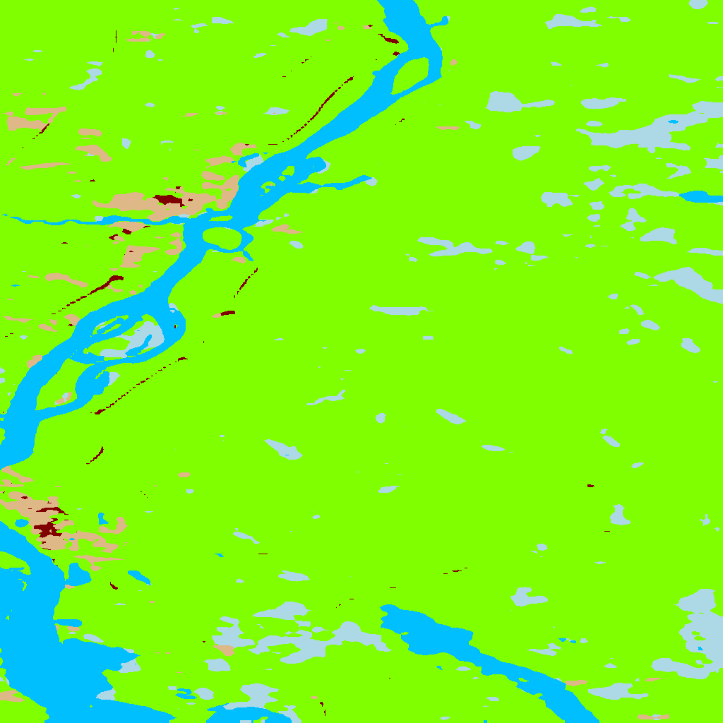
EXAMPLE TRAIN / RESULT DATA

Slide 14
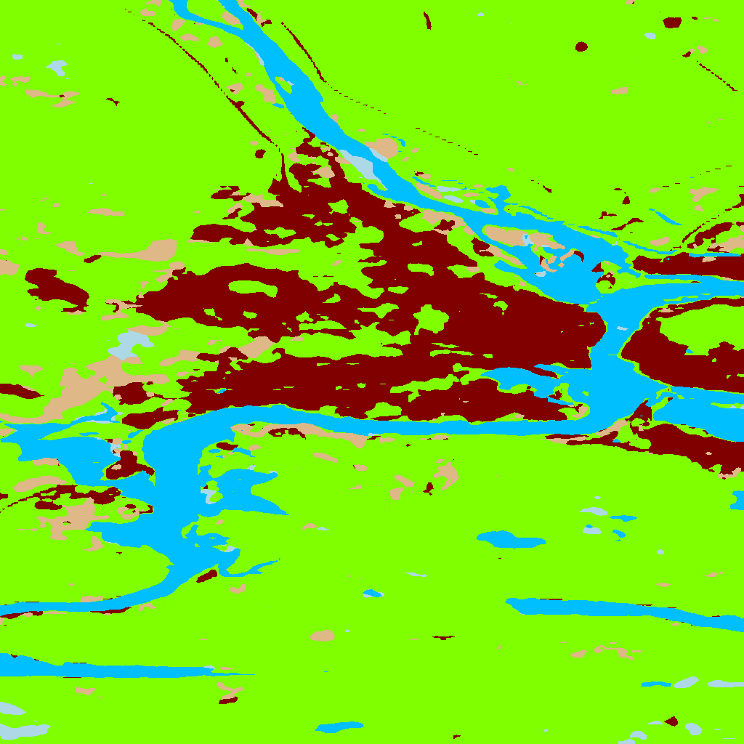
EXAMPLE TRAIN / RESULT DATA

Slide 15
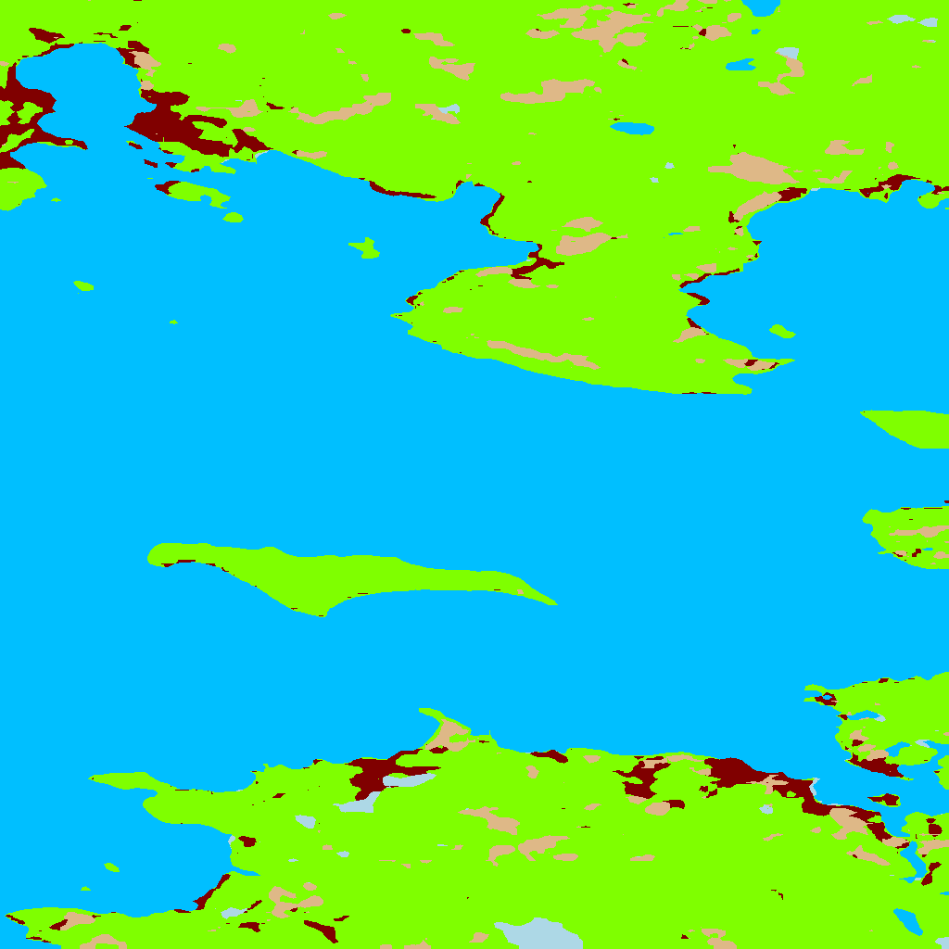
EXAMPLE TRAIN / RESULT DATA

Slide 16
EXAMPLE TRAIN /LABEL DATA/ RESULT DATA

Slide 17
EXAMPLE TRAIN /LABEL DATA/ RESULT DATA

Slide 18
EXAMPLE TRAIN / LABEL DATA / RESULT DATA

Slide 19
FUTURE WORK
calibration of Sentinel data using ESA SNAP
stratified sampling
change of train/validate/test data sets ratios
use of higher resolution SAR data (ICEYE-X series)
fine tuning of network architecture

